Slide 1
RNA-Seq Bioinformatics Applications (PLPTH813)
Sanzhen Liu
4/18/2023

Slide 2
Schedule
Presentation
May 2nd (3)
May 4th (3 morning and 6 afternoon)
Final exam
May 11th 9:30 am – 12:00pm

Slide 3
BED format and BEDtools
chr1 0 100 region1 . +
chr1 100 200 region2 . -
…
BEDtools
intersect Find overlapping intervals in various ways.
getfasta Use intervals to extract sequences from a FASTA file.
…

Slide 4
conda
Conda can be a powerful tool to manage dependencies and environments and makes it easy to install and use complex software packages.

Slide 5
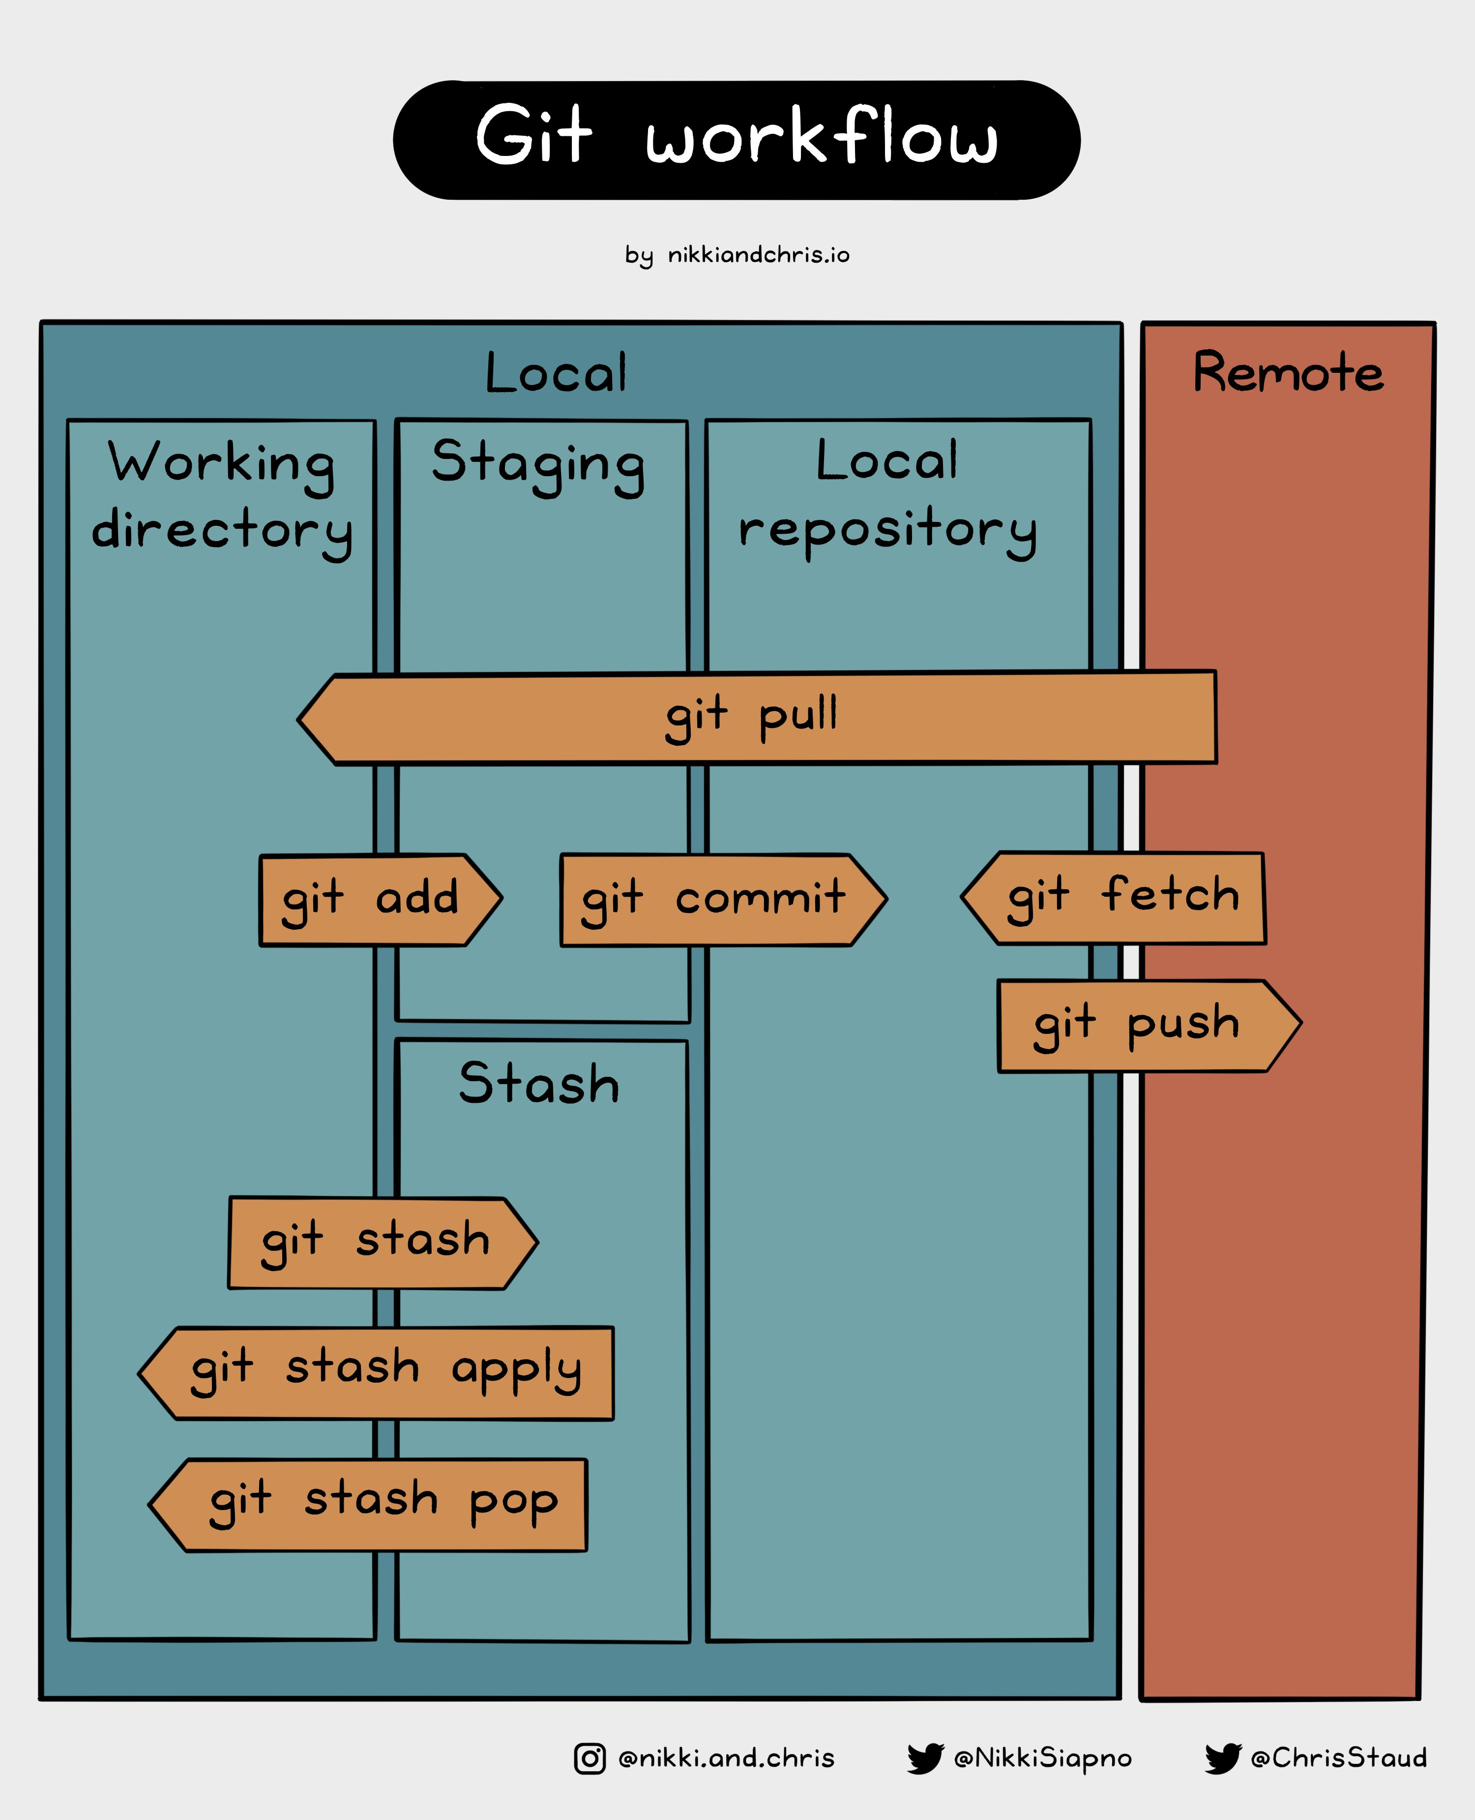
GitHub Cheat Sheet

Slide 6
maxium likelihood tree covid.2.treefile
+-----------------------------------------------------------s1
|
+--s2
|
+--s3
Tree in newick format:
(s1:9.9999988658,s2:0.0702378591,s3:0.0647318661);

Slide 7
Outline
Introduction of RNA-Seq
RNA-Seq procedure
Reference guided assembly
RNA-Seq de novo assembly
PacBio Iso-Seq
Nanopore RNA-Seq

Slide 8
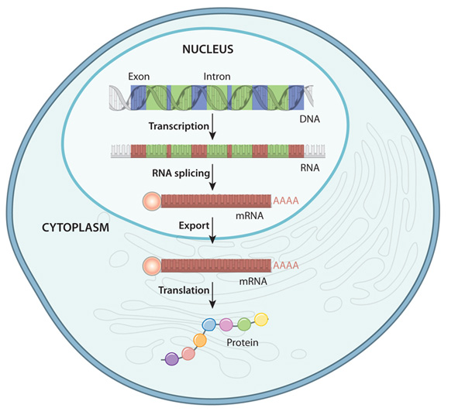
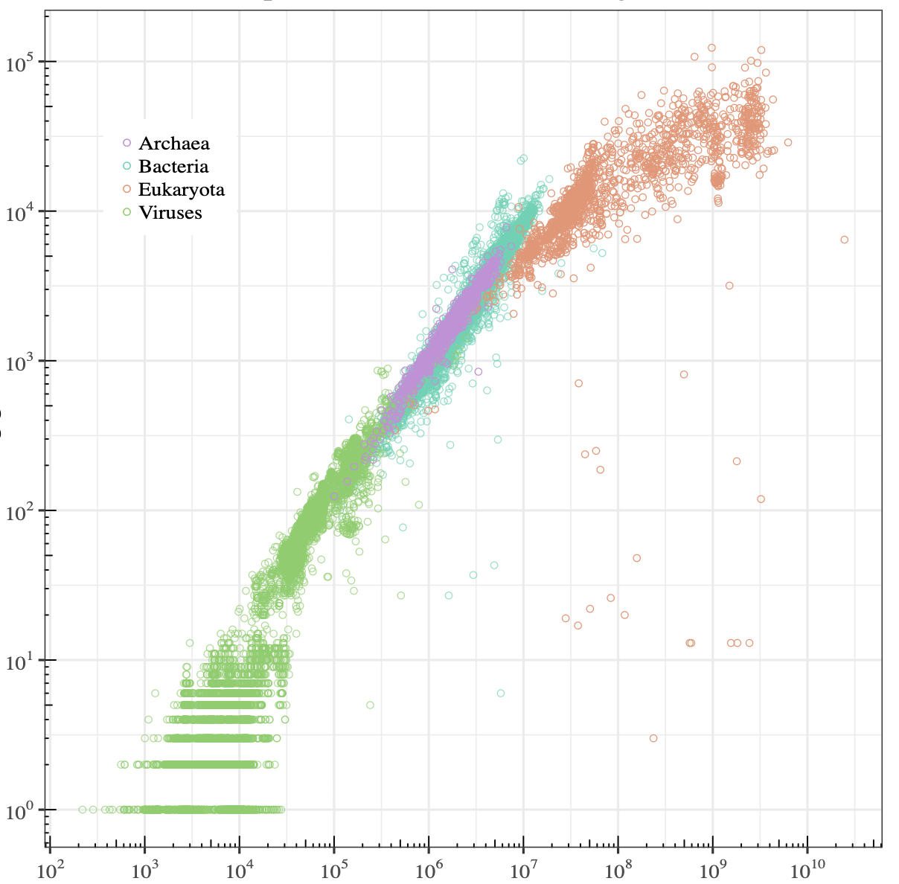
Transcriptome
A transcriptome is the full range of mRNA expressed by a cell, a tissue, or an organism.
10⁵
eukaryota
10⁴
bacteria
10³
archaea
Counts of protein genes
10²
10
viruses
10³
10⁵
10⁷
10⁹
Genome size (bp)
DNA to protein in eukaryote
wikipedia.org
nature.com/scitable/topicpage/gene-expression-14121669
Notes:
the set of mRNA transcripts produced in a particular cell or tissue type

Slide 9
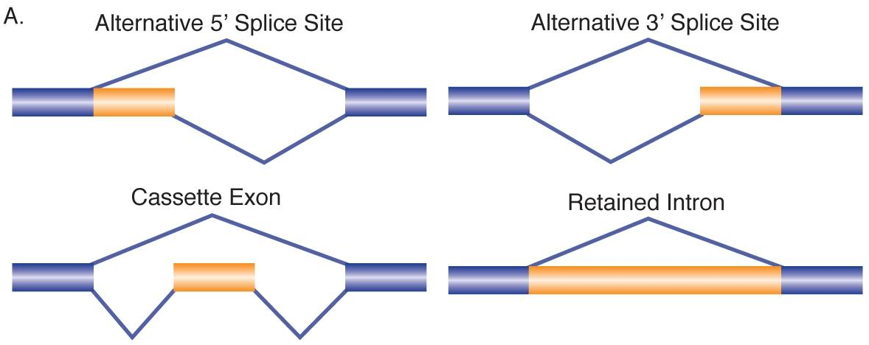
Alternative splicing
Genome
transcription
exon
intron
Pre-mRNA
5'
AAAAA 3'
mRNA
transcript
5'
AAAAA 3'
alternative splicing
5'
AAAAA 3'
isoforms
Curr Opin Genet Dev. 21(4): 373–379 (2011)

Slide 10
levels of alternative splicing
In many eukaryotic organisms, the majority of genes are alternatively spliced to produce multiple transcript isoforms.
In humans, for example, there is evidence for alternative splicing of more than 95% of genes, with an average of more than five isoforms per gene.
- Tilgner et al. (2014) PNAS

Slide 11
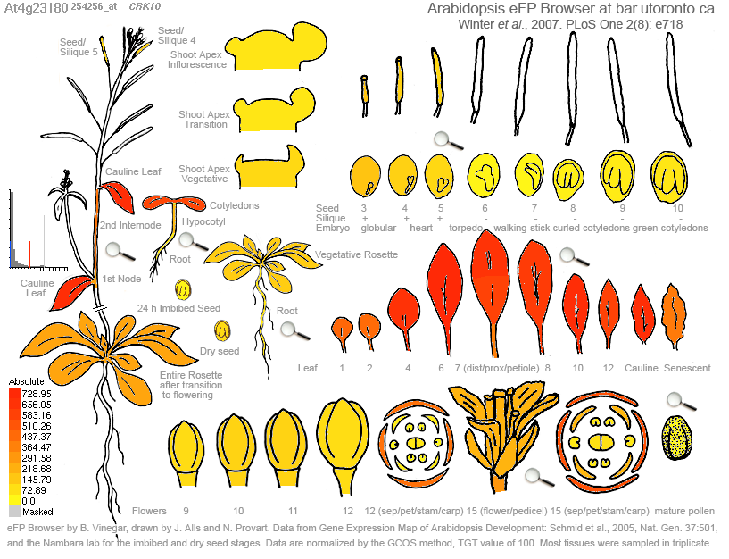

Transcriptome analysis (RNA-seq)
cragenomica.es
Expression profiles in different tissues
Response to biotic stress
1. What are sequences of transcripts?
2. What is the expression level of each transcript?
RNA-seq well addresses both questions

Slide 12
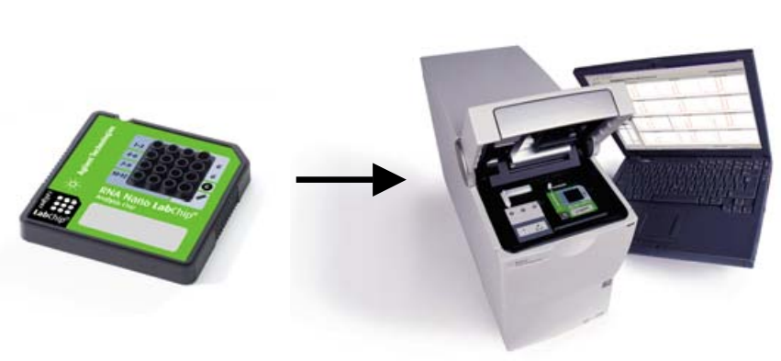
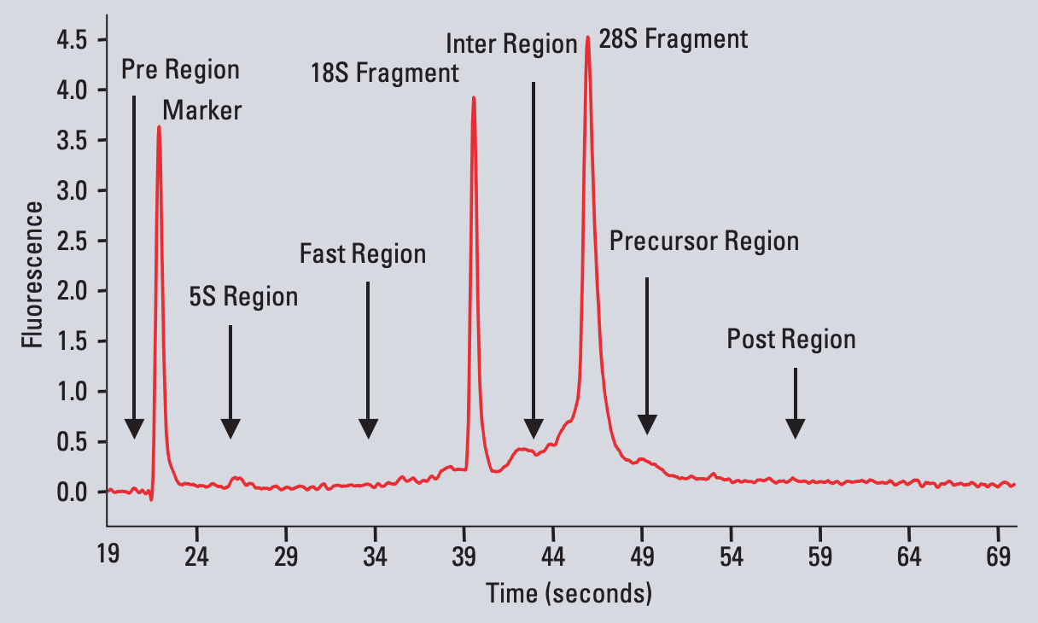
total RNA
RNA-seq
total RNA
Bioanalyzer
mRNA
RIN: RNA Integrity Number
a value from 1 to 10, with 10 being the least degraded.
DNA library
sequencing
reads
https://www.agilent.com/cs/library/applications/5989-1165EN.pdf

Slide 13
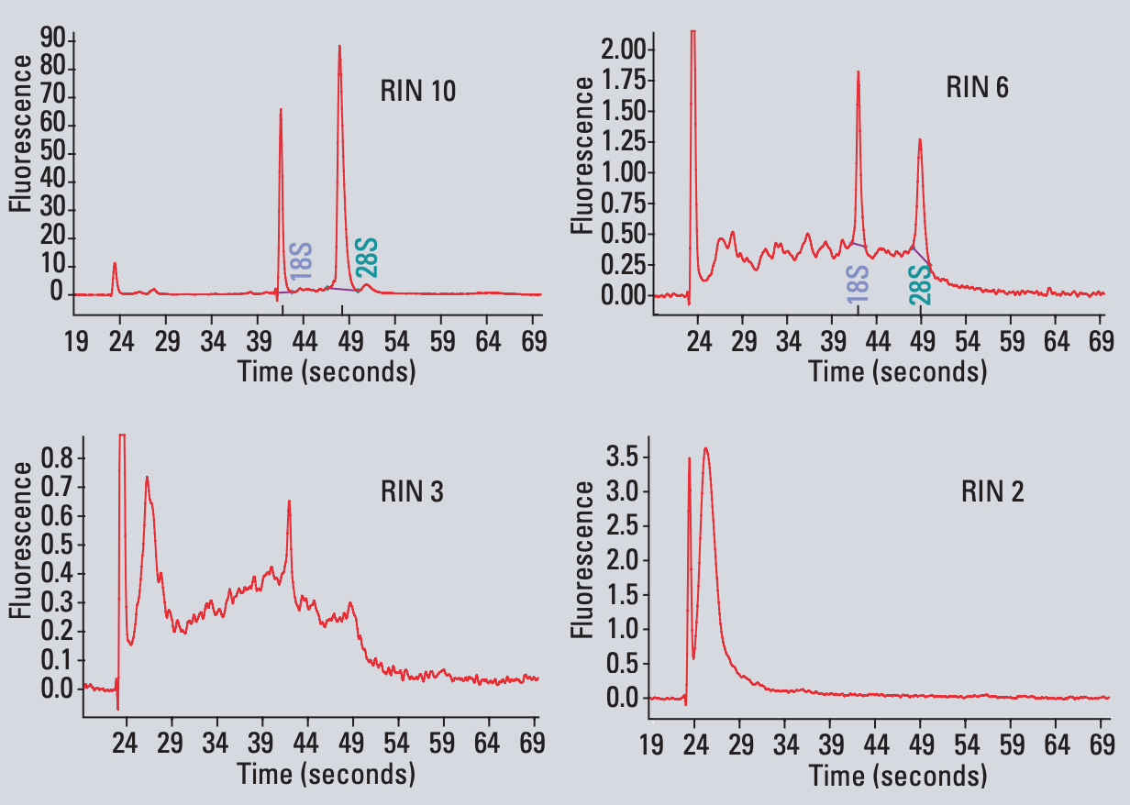
total RNA
RNA-Seq
total RNA
mRNA
DNA library
sequencing
reads
https://www.agilent.com/cs/library/applications/5989-1165EN.pdf

Slide 14
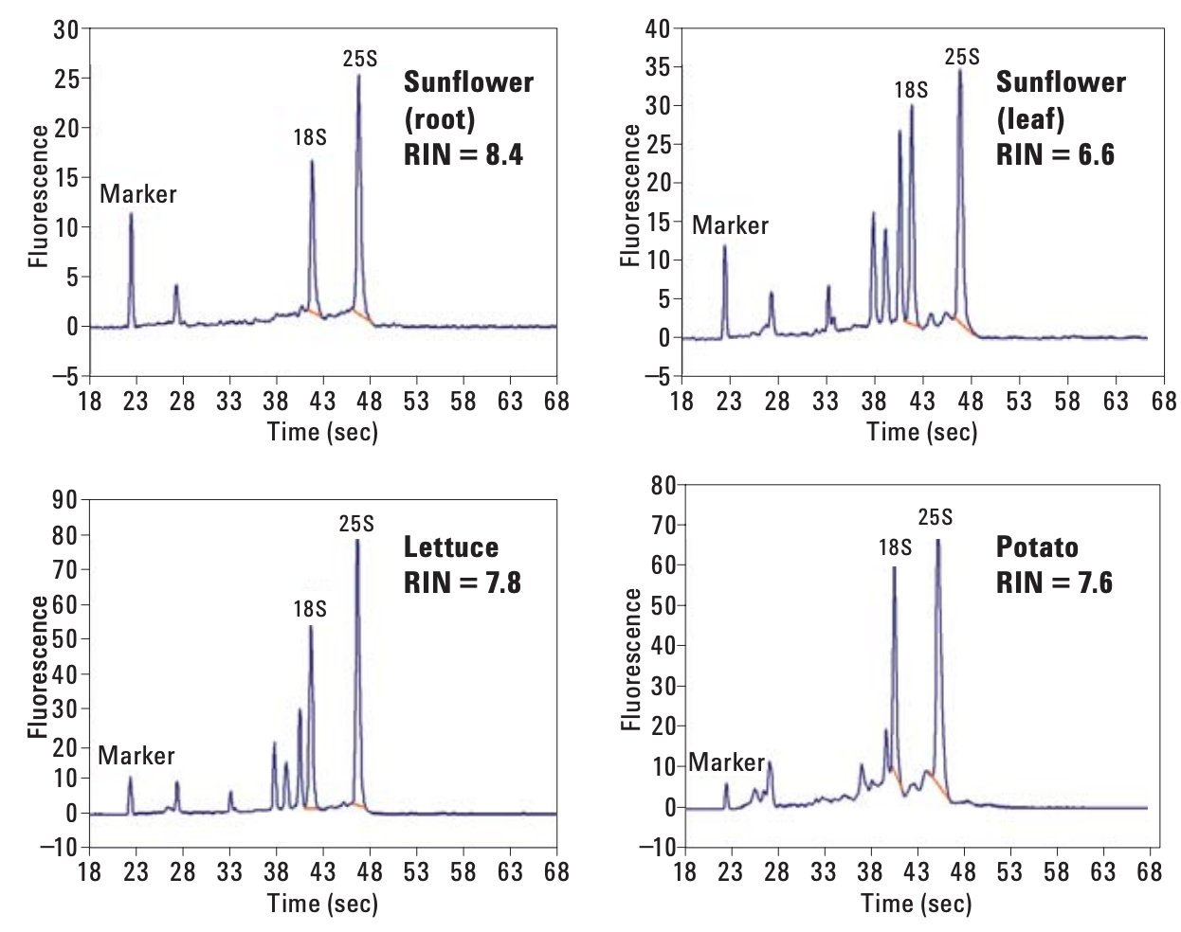
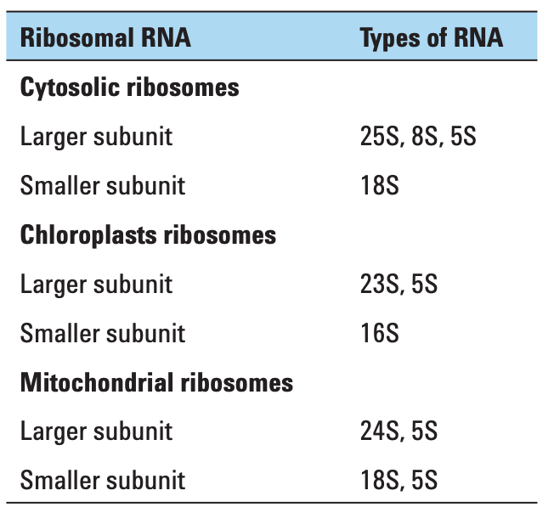
total RNA of plant tissues
Result of plant total RNA using the RNA 6000 Nano Kit
Table. Plant total RNA
https://www.agilent.com/cs/library/applications/5990-8850EN.pdf

Slide 15
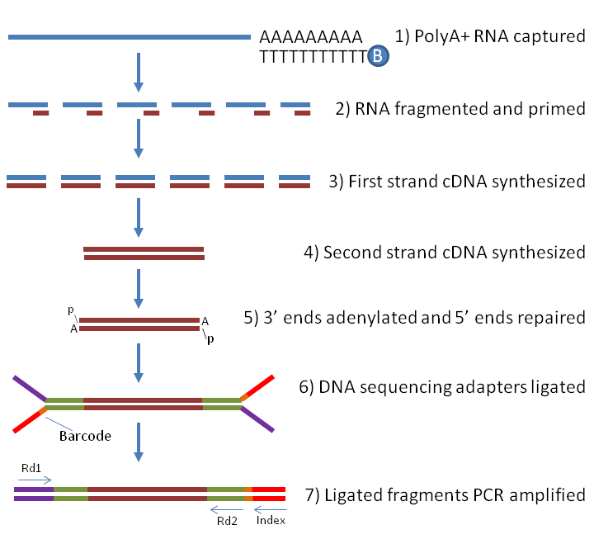
Illumina RNA-Seq library preparation
total RNA
mRNA
DNA library
sequencing
reads
PCR
labome.com/method/RNA-seq-Using-Next-Generation-Sequencing.html
review paper: doi.org/10.1093/nar/gky167

Slide 16
Illumina sequencing
total RNA
Single-end reads
Paired-end reads
mRNA
DNA library
sequencing
reads
5'
AAAAA 3'
reads
How to reconstruct full-length transcripts from short reads?

Slide 17
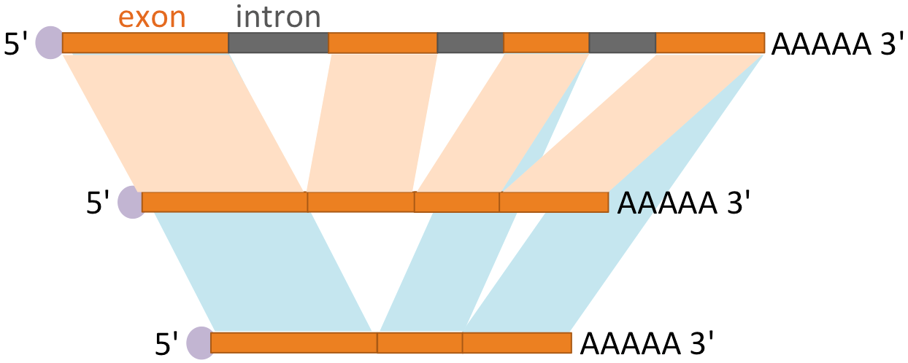
Challenges of reconstruction of full-length transcripts (transcriptome assembly)
Sequencing errors
Repeats in different genes
Various coverage on different transcripts
Read coverage may be uneven across the transcript’s length, owing to sequencing biases
Alternative splicing greatly complicates transcriptome assembly
Nature Biotechnology 29, 644–652 (2011)

Slide 18
Two main strategies for transcriptome assembly
RNA-seq
reads
Reference guided
assembly
de novo assembly

Slide 19
Reference-guided transcriptome assembly
RNA-seq
reads
Reference guided assembly (Cufflinks)
1. alignment to the reference genome
2. assembly based on alignments
Question: Using a genome as the reference, what difference between RNA-seq alignments and DNA-seq alignments?

Slide 20
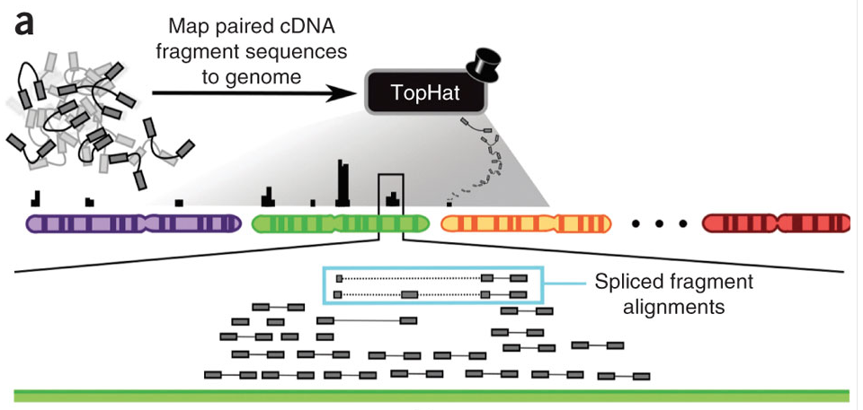
Cufflinks - spliced alignments
split read
(Intron-spanning read)
Nature Biotechnology 28, 511–515 (2010)
Notes:
(a) The algorithm takes as input cDNA fragment sequences that have been aligned to the genome by software capable of producing spliced alignments, such as TopHat

Slide 21
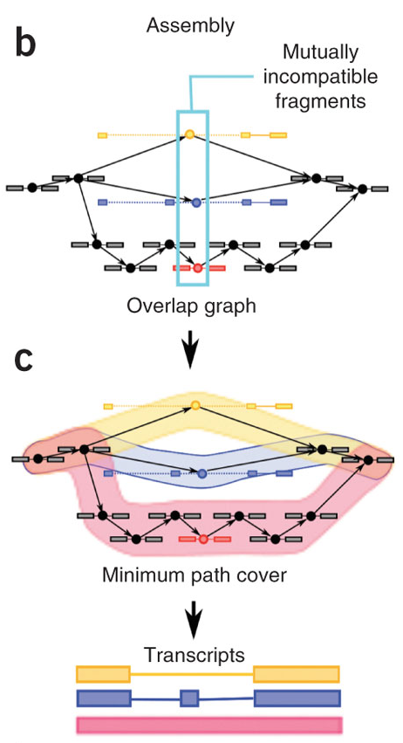
Cufflinks - assembly
Overlapping graph is made up with compatible fragments (nodes) and alignments overlap in the genome
Incompatible fragments are fragments originated from distinct spliced mRNA isoforms
Isoforms are assembled from the overlap graph
Nature Biotechnology 28, 511–515 (2010)

Slide 22
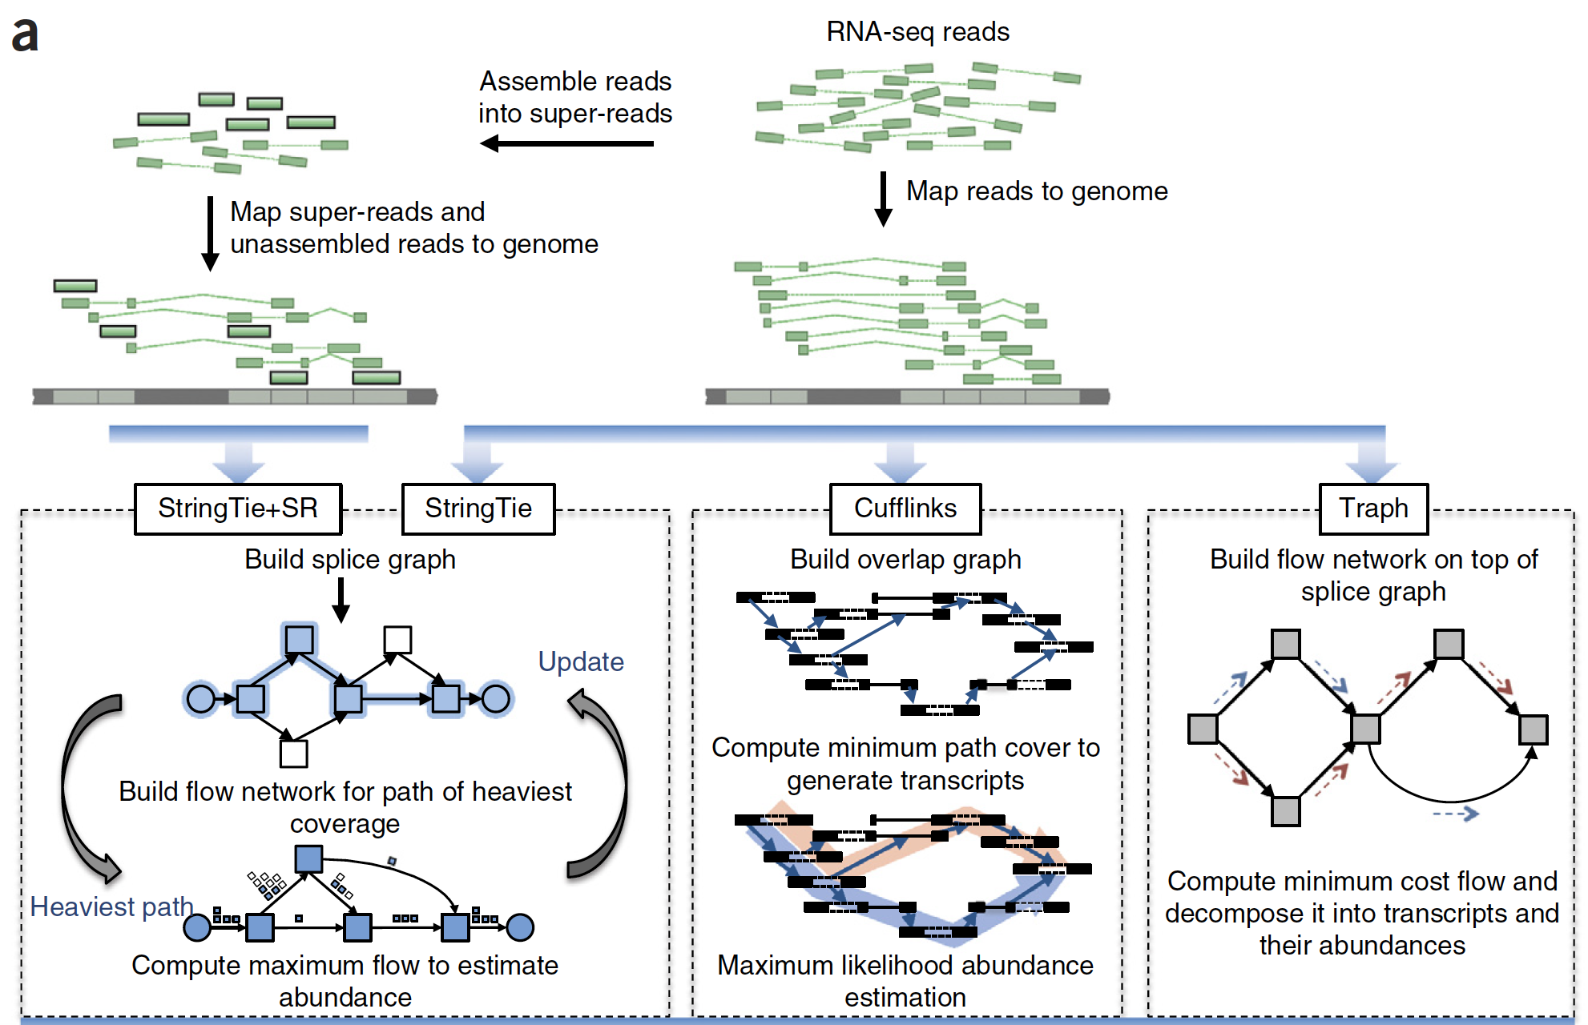
StringTie
StringTie produces more complete and accurate reconstructions of genes and better estimates of expression levels, compared with Cufflinks, IsoLasso, Scripture and Traph.

Slide 23
Pros and cons of reference-guided assembly
Theoretically, reference-guided assembly promises maximum sensitivity
The quality of assembly is depended on the accuracy of read-to-reference alignments, which are complicated by splicing, sequencing errors and the lack or incompleteness of many reference genomes
Alignments are even more complicated when the species used to construct a reference genome is distant from the species that is used for constructing a reference genome

Slide 24
De novo assembly
De novo transcriptome assembly is to perform an assembly from scratch, which does not rely on read-reference alignments.
De novo transcriptome assembly is important when the genomic sequence is not available, gapped, highly fragmented, or substantially different with the reference genome.

Slide 25

Trinity
step 1: Inchworm assembles reads into unique sequences of transcripts (reads to contigs)
step 2: Chrysalis clusters related contigs (contigs to clusters)
step 3: Butterfly analyzes the paths taken by reads in the context of the corresponding de Bruijn graph and reports all plausible transcripts (cluster to transcripts)
Nature Biotechnology 29, 644–652 (2011)
Notes:
Inchworm assembles the RNA-seq data into the unique sequences of transcripts, often generating full-length transcripts for a dominant isoform, but then reports just the unique portions of alternatively spliced transcripts.
Chrysalis clusters the Inchworm contigs into clusters and constructs complete de Bruijn graphs for each cluster. Each cluster represents the full transcriptonal complexity for a given gene (or sets of genes that share sequences in common). Chrysalis then partitions the full read set among these disjoint graphs.
Butterfly then processes the individual graphs in parallel, tracing the paths that reads and pairs of reads take within the graph, ultimately reporting full-length transcripts for alternatively spliced isoforms, and teasing apart transcripts that corresponds to paralogous genes.

Slide 26
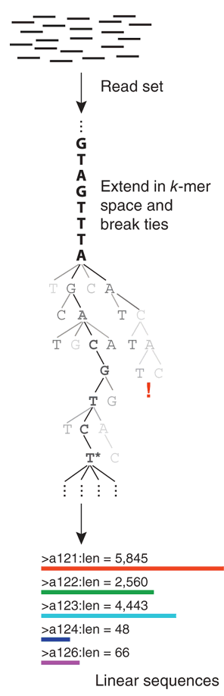
Trinity – Inchworm a k-mer–based approach for transcript assembly
A:1
C:4
A:5
G:5
A:6
…
C:2
T:3
GTAGTTTA
C:8
…
G:5
A:8
G:0
T:4
C:3
G:7
T:2
Contig: …GTAGTTTAGAC…
T:0
…
GTAGTTTA
(most abundant)
TAGTTTAG
AGTTTAGA
GTTTAGAC
…
Notes:
(i) constructs a k-mer dictionary from all sequence reads (in practice, k = 25);
(ii) removes likely error-containing k-mers from the k-mer dictionary;
(iii) selects the most frequent k-mer in the dictionary to seed a contig assembly, excluding both low-complexity and singleton k-mers (appearing only once);
(iv) extends the seed in each direction by finding the highest occurring k-mer with a k − 1 overlap with the current contig terminus and concatenating its terminal base to the growing contig sequence (once a k-mer has been used for extension, it is removed from the dictionary);
(v) extends the sequence in either direction until it cannot be extended further, then reports the linear contig;
(vi) repeats steps iii–v, starting with the next most abundant k-mer, until the entire k-mer dictionary has been exhausted

Slide 27
Trinity - Inchworm
Inchworm assembles reads into the unique sequences of transcripts (contigs), recovering only a single (best) representative for a set of alternative variants that share k-mers.
The contigs alone do not capture the full complexity of the transcriptome
Notes:
(i) constructs a k-mer dictionary from all sequence reads (in practice, k = 25);
(ii) removes likely error-containing k-mers from the k-mer dictionary;
(iii) selects the most frequent k-mer in the dictionary to seed a contig assembly, excluding both low-complexity and singleton k-mers (appearing only once);
(iv) extends the seed in each direction by finding the highest occurring k-mer with a k − 1 overlap with the current contig terminus and concatenating its terminal base to the growing contig sequence (once a k-mer has been used for extension, it is removed from the dictionary);
(v) extends the sequence in either direction until it cannot be extended further, then reports the linear contig;
(vi) repeats steps iii–v, starting with the next most abundant k-mer, until the entire k-mer dictionary has been exhausted

Slide 28
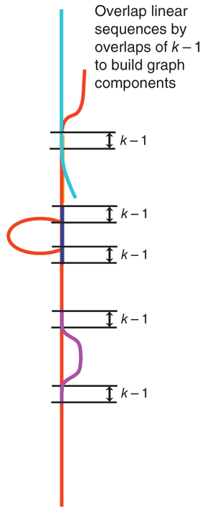
Trinity - Chrysalis
step 2: Chrysalis clusters related contigs
Chrysalis then constructs a de Bruijn graph for each cluster of related contigs
Determine components. Each component defines a collection of contigs that are likely to be derived from alternative splice forms or closely related paralogs.
Notes:
Each component defines a collection of Inchworm contigs that are likely to be derived from alternative splice forms or closely related paralogs.
(i) It recursively groups Inchworm contigs into connected components.
*Contigs are grouped if there is a perfect overlap of k − 1 bases between them and if there is a minimal number of reads that span the junction across both contigs with a (k − 1)/2 base match on each side of the (k − 1)-mer junction.
(ii) It builds a de Bruijn graph for each component using a word size of k − 1 to represent nodes, and k to define the edges connecting the nodes.
(iii) It assigns each read to the component with which it shares the largest number of k-mers, and determines the regions within each read that contribute k-mers to the component.

Slide 29
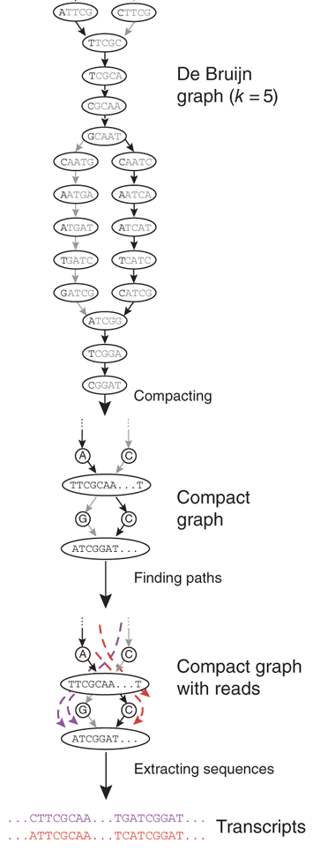
Trinity - Butterfly
step 3: Butterfly reconstructs plausible, full-length, linear transcripts by reconciling the individual de Bruijn graphs generated by Chrysalis with the original reads and paired ends.
Butterfly resolves alternatively spliced isoforms and transcripts derived from paralogous genes.
Notes:
Butterfly reconstructs plausible, full-length, linear transcripts by reconciling the individual de Bruijn graphs generated by Chrysalis with the original reads and paired ends.
During the first part, called graph simplification, Butterfly iterates between (i) merging consecutive nodes in linear paths in the de Bruijn graph to form nodes that represent longer sequences and (ii) pruning edges that represent minor deviations (supported by comparatively few reads), which likely correspond to sequencing errors. Diploid polymorphisms are expected to be more frequent than sequencing errors and will likely be maintained. In the second part, called plausible path scoring, Butterfly identifies those paths that are supported by actual reads and read pairs, using a dynamic programming procedure that traverses potential paths in the graph while maintaining the reads (and pairs) that support them. Because reads and sequence fragments (paired reads) are typically much longer than k, they can resolve ambiguities and reduce the combinatorial number of paths to a much smaller number of actual transcripts, enumerated as linear sequences.

Slide 30
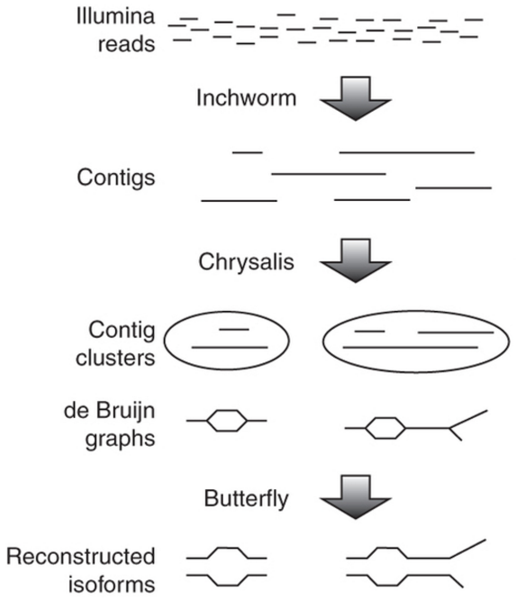
Trinity summary
K
reads to contigs
contigs to cluster/graph
graph to transcripts
K-1

Slide 31
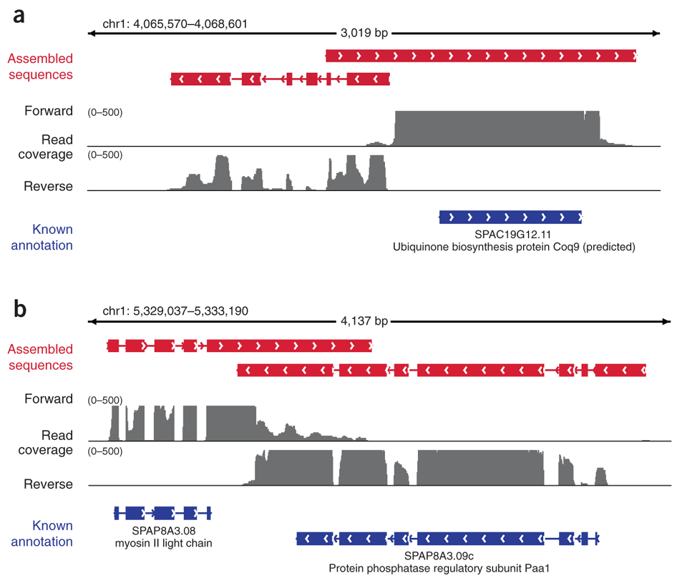
De novo assembly could correct wrong annotations

Slide 32
Note
Trinity also provides an option to perform reference-guided transcriptome assembly
https://github.com/trinityrnaseq/trinityrnaseq/wiki/Genome-Guided-Trinity-Transcriptome-Assembly

Slide 33
Outline
Introduction of RNA-Seq
RNA-Seq procedure
Reference guided assembly
RNA-Seq de novo assembly
PacBio Iso-seq

Slide 34
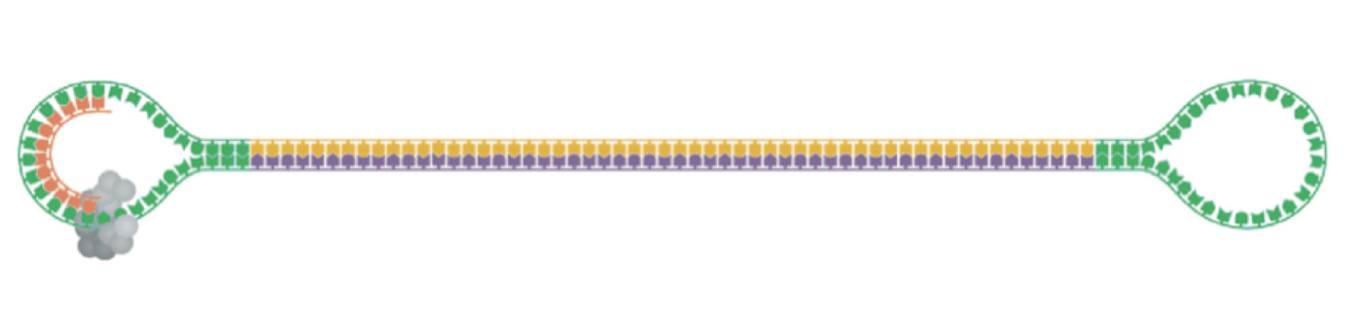
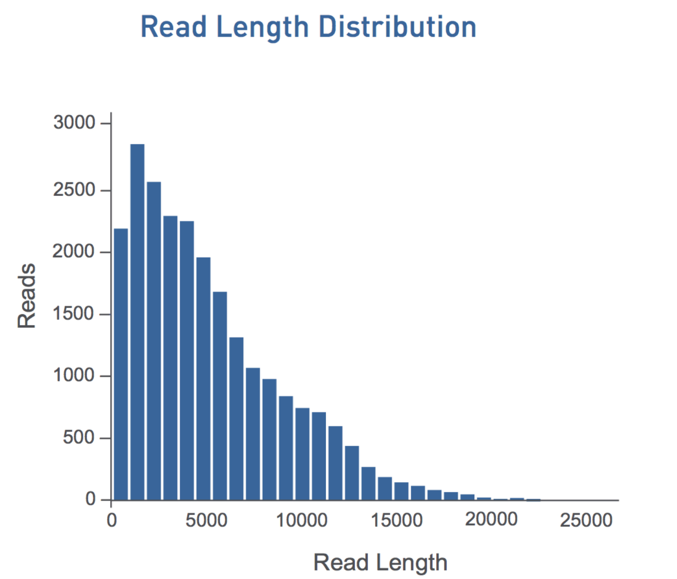
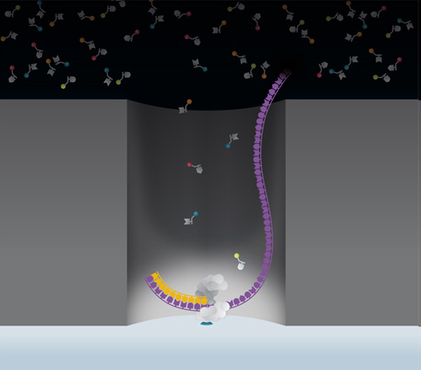
PacBio long reads for RNA sequencing (Iso-Seq)
Iso-Seq for analyzing full-length transcripts
High-quality, single-molecule, circular-consensus (CCS)
http://flxlexblog.wordpress.com/2013/02/11/applications-for-pacbio-circular-consensus-sequencing/

Slide 35
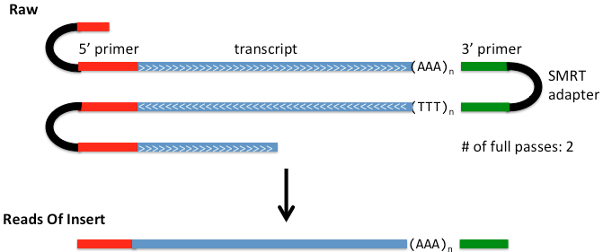
Multiple passes improve sequence quality
https://github.com/PacificBiosciences/cDNA_primer/wiki/Understanding-PacBio-transcriptome-data

Slide 36
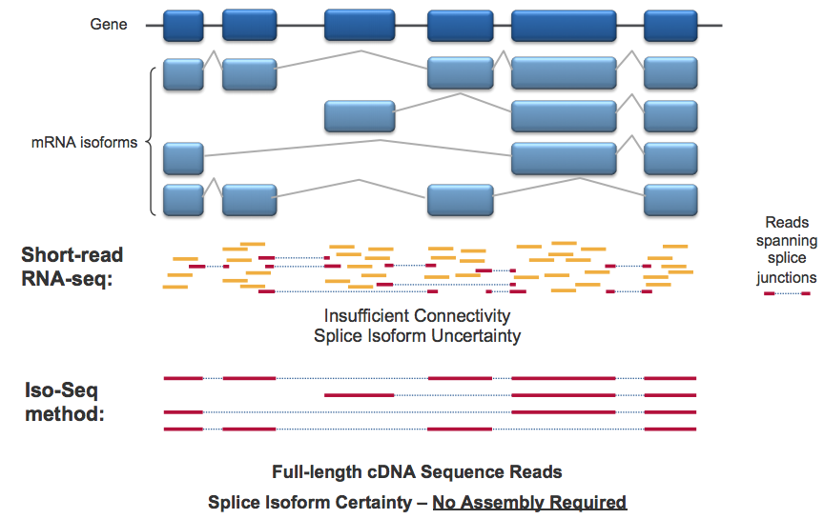
Long-read, full-length, no assembly required

Slide 37
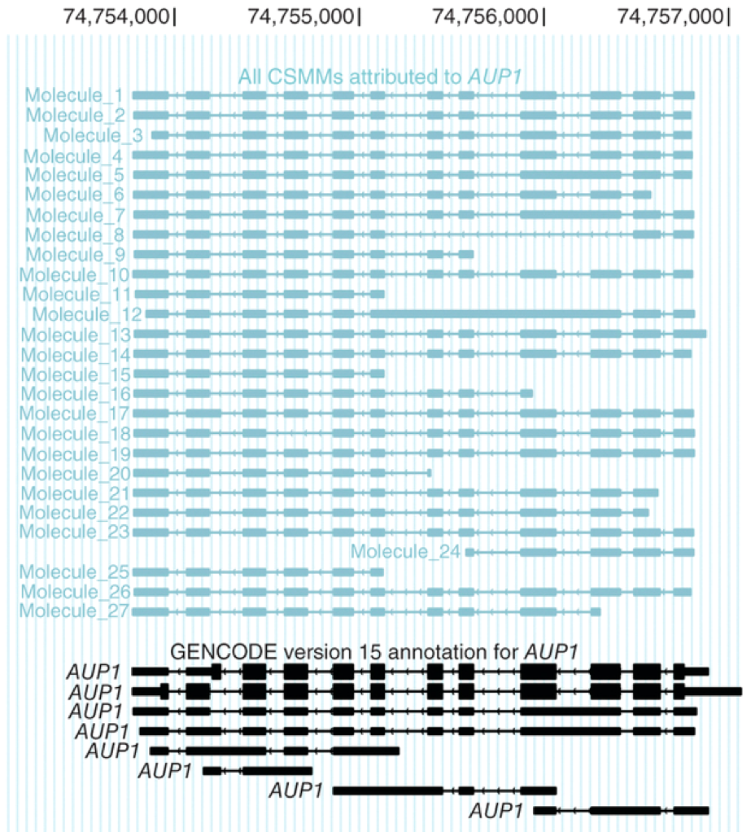
Long reads to sequence full-length cDNA
The majority of reads represent all splice sites of original transcripts
Isoforms can be monitored at a single-molecule level without amplification or fragmentation
Sharon et al. Nature Biotechnology 31, 1009–1014 (2013)

Slide 38
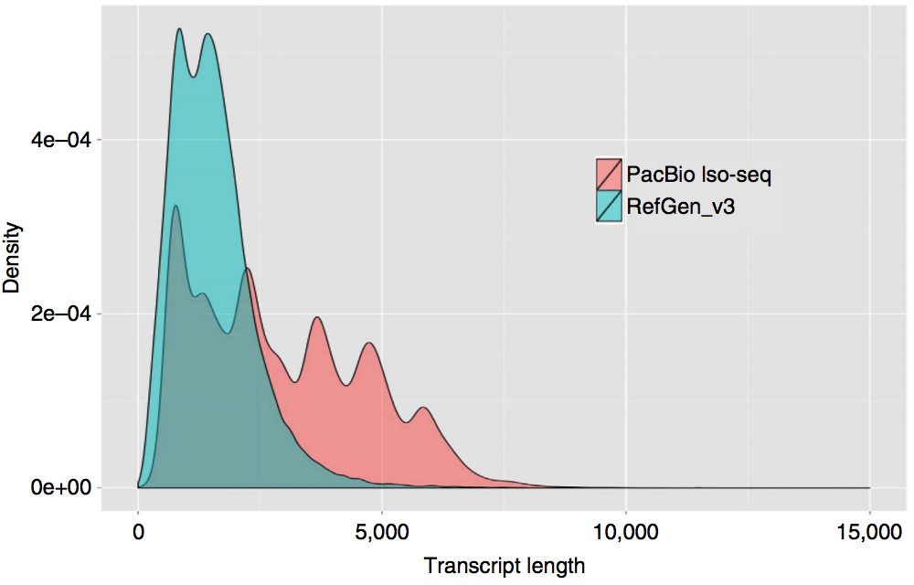
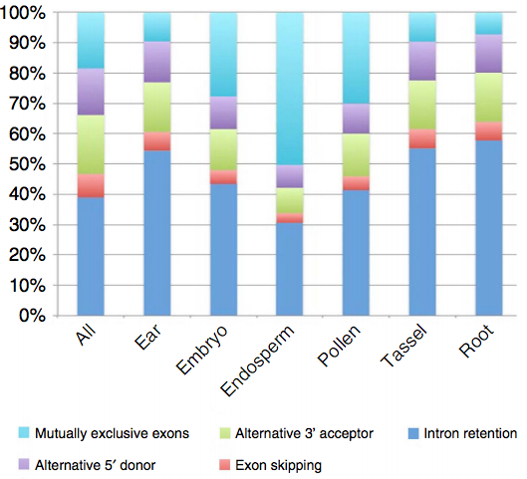
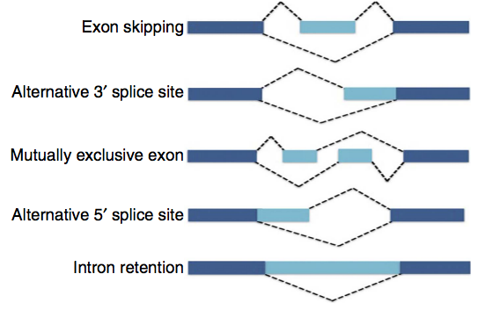
maize – Iso-Seq
Wang et al., Nature Communications, 2016, 7:11708

Slide 39
Nanopore provides long RNA-Seq reads
 | Direct RNA Sequencing | cDNA-PCR Sequencing | Direct cDNA Sequencing
Input | 500 ng RNA (polyA) | 1 ng RNA (polyA) | 100 ng RNA (polyA)
RT required | Optional | Yes | Yes
PCR required | No | Yes | No
Read length | Equal to RNA length | Enriched for full-length cDNA | Enriched for full-length cDNA
Typical # reads (MinION) | 1 million | 7 - 12 million | 5 - 10 million

Slide 40
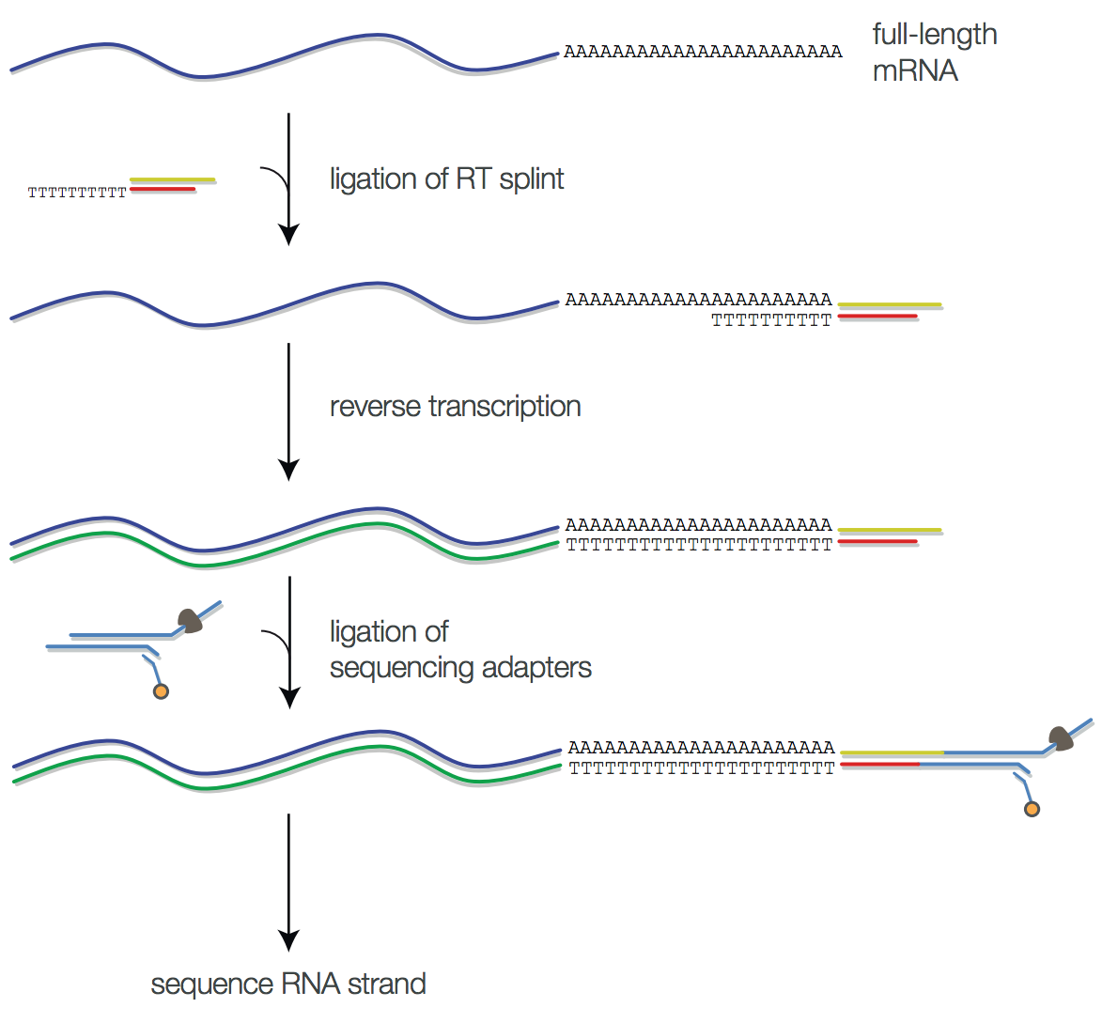
Nanopore – Direct RNA Sequencing (DRS)
http://biorxiv.org/content/early/2016/08/12/068809

Slide 41
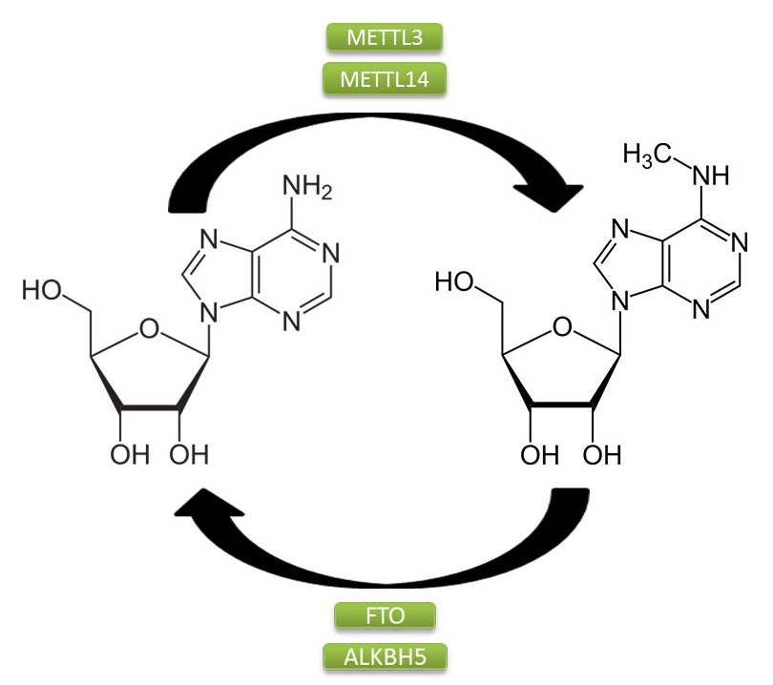
Application of Nanopore DRS
Nanopore DRS detects long, complex mRNAs and short, structured non-coding RNAs
Spurious antisense reads are rare or absent in nanopore DRS (strand specific RNA)
Nanopore DRS confirms sites of RNA 3′ end formation and estimates poly(A) tail length
DRS detect m⁶A modification of RNA
eLife 2020;9:e49658
https://www.epigentek.com/catalog/the-role-of-m6a-rna-modification-in-cancer-n-16.html

Slide 42
References
Cufflinks paper: Trapnell C et al., Transcript assembly and quantification by RNA-Seq reveals unannotated transcripts and isoform switching during cell differentiation. Nat Biotechnol. 2010, 28, 511–5.
Tophat-Cufflinks-Cuffdiff-CummeRbund protocol: Trapnell C et al., Differential gene and transcript expression analysis of RNA-seq experiments with TopHat and Cufflinks. Nat Protocols. 2012, 7, 562–578.
Trinity paper: Grabherr MG et al., Full-length transcriptome assembly from RNA-seq data without a reference genome. Nat Biotechnol. 2011, 29:644-52.
Protocol for using Trinity: Haas BJ et al., De novo transcript sequence reconstruction from RNA-seq using the Trinity platform for reference generation and analysis. Nat Protoc. 2013, 8:1494-512.
Performance tuning of Trinity: Henschel R et al., Trinity RNA-Seq assembler performance optimization. XSEDE 2012 Proceedings of the 1st Conference of the Extreme Science and Engineering Discovery Environment: Bridging from the eXtreme to the campus and beyond.

